Slide 1
MS Azure – Day 4

Slide 2
Azure identity, access, and security

Slide 3
What you will learn
At the core of the lesson
You will learn:
Understanding Azure Active Directory.
Authentication methods in Azure, including single sign-on (SSO), multifactor authentication (MFA), and password less.
Azure Role Based Access Control (RBAC)
Purpose of the defense in depth model
Purpose of Microsoft Defender for Cloud

Slide 4
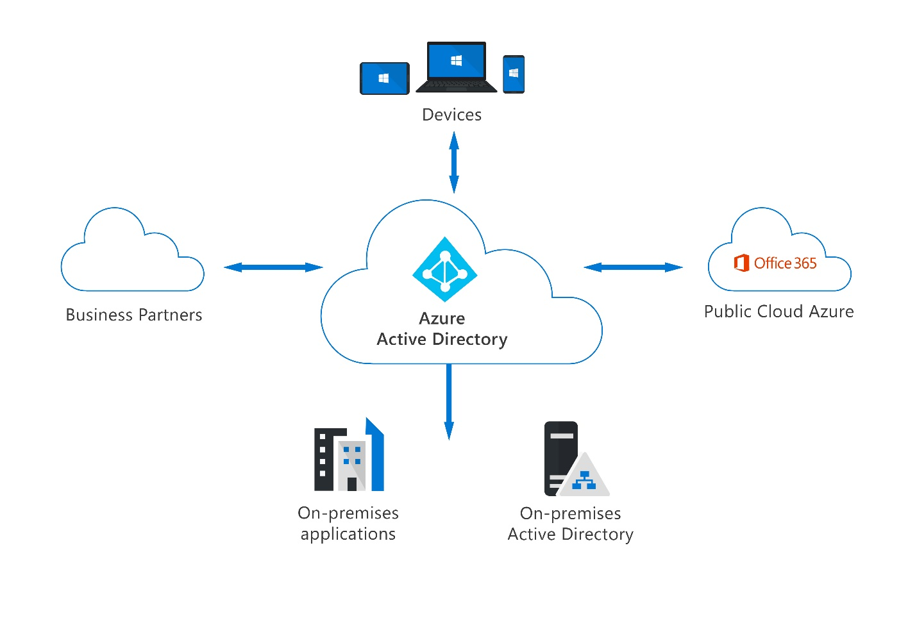
Understanding Azure Active Directory
Cloud-based identity and access management service.
We can create users and groups in Azure AD.
Notes:
Chapter4 – Azure Active Directory
Using Azure AD, we can give access to resources in Azure to users created in AD.
We can grant different roles to users in Azure AD, Assign licenses to users.
Connect on-premises AD with Azure AD.

Slide 5
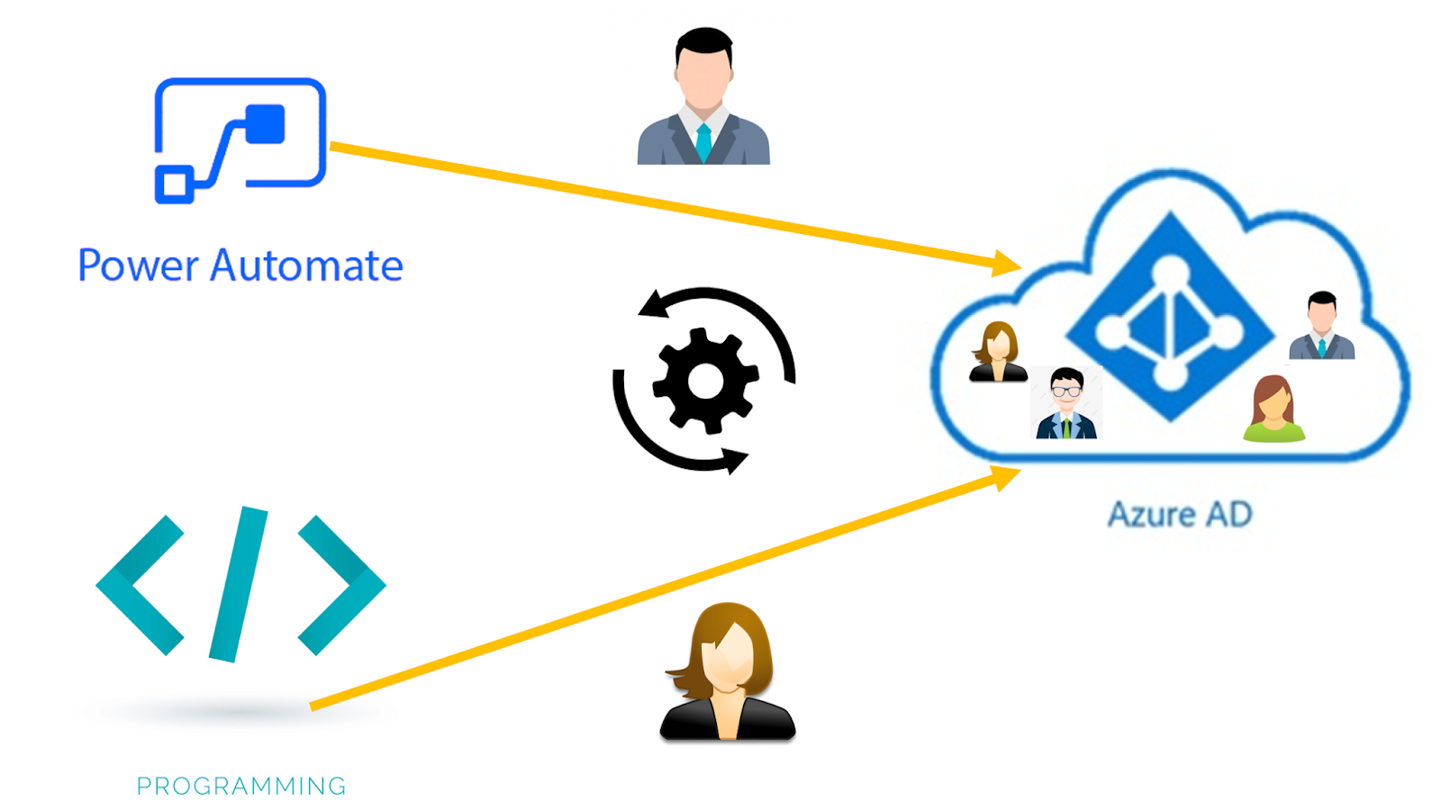
Azure AD Users
A user is an individual who needs to access resources, such as virtual machines, databases, or applications.
You can also assign permissions to users or groups to control who can access your resources and what they can do with them.

Slide 6
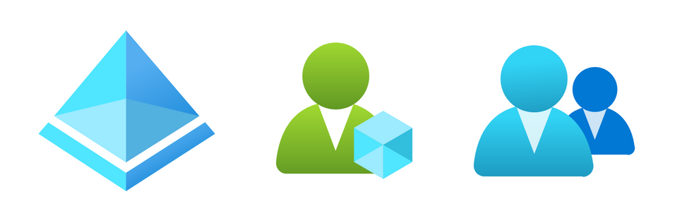
Azure AD Groups
Used to manage users that need the same access and permissions to resources, such as apps, services, licenses, or roles.
The All-Users group is a default group that includes all users in the Azure AD directory.

Slide 7
Azure AD use-cases
IT administrators
App developers
Online service subscribers
Users.
Notes:
Chapter4 – Azure Active Directory
IT administrators use Azure AD to control access to apps and app resources, based on business requirements.
App developers can use Azure AD as a standards-based authentication provider that helps them add single sign-on (SSO) to apps that works with a user's existing credentials.
Microsoft 365, Office 365, Azure, or Dynamics CRM Online subscribers already use Azure AD as every Microsoft 365, Office 365, Azure, and Dynamics CRM Online tenant is automatically an Azure AD tenant. You can immediately start managing access to your integrated cloud apps.
Users. Users can manage their identities and take maintenance actions like self-service password reset.

Slide 8
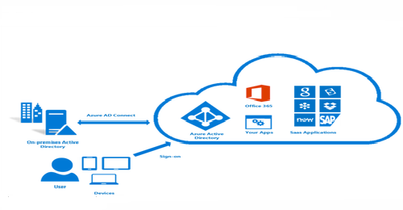
Azure AD provides services such as:
Authentication
Single sign-on
Application management
Device management
Notes:
Chapter4 – Azure Active Directory
Authentication: This includes verifying identity to access applications and resources.
Single sign-on: Single sign-on (SSO) enables you to remember only one username and one password to access multiple applications.
Application management: You can manage your cloud and on-premises apps by using Azure AD.
Device management: Along with accounts for individual people, Azure AD supports the registration of devices.

Slide 9
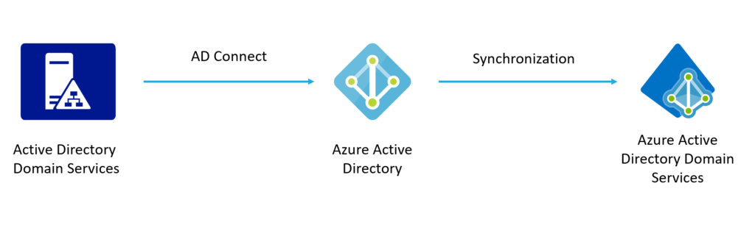
Azure Active Directory Domain Services
Azure Active Directory Domain Services provides scalable, high-performance, managed domain services such as domain-join, LDAP, Kerberos, Windows Integrated authentication and group policy.
Notes:
Chapter4 – Azure Active Directory
When you create an Azure AD DS managed domain, you define a unique namespace. This namespace is the domain name. Two Windows Server domain controllers are then deployed into your selected Azure region. This deployment of DCs is known as a replica set.
You don't need to manage, configure, or update these DCs. The Azure platform handles the DCs as part of the managed domain, including backups and encryption at rest using Azure Disk Encryption.

Slide 10
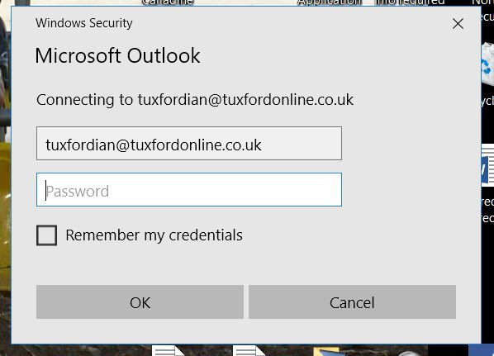
Azure authentication methods
Authentication is the process of proving that you're who you say you are. This is achieved by verification of the identity of a person or device.
Notes:
Chapter4 – Azure Active Directory
Authentication is like presenting ID when you’re traveling. It doesn’t confirm that you’re ticketed, it just proves that you're who you say you are. Azure supports multiple authentication methods, including standard passwords, single sign-on (SSO), multifactor authentication (MFA), and passwordless.

Slide 11
Azure supports multiple authentication methods
Standard passwords
Single sign-on (SSO)
Multifactor authentication (MFA)
Passwordless
Notes:
Chapter4 – Azure Active Directory
Single sign-on (SSO) is an authentication solution that allows users to log in to multiple applications and websites with one-time user authentication.
Multifactor authentication (MFA) is a security technology that requires multiple methods of authentication from independent categories of credentials to verify a user's identity for a login or other transaction. Multifactor authentication combines two or more independent credentials.
Passwordless authentication Passwordless authentication methods are more convenient because the password is removed and replaced with something you have, plus something you are, or something you know.

Slide 12
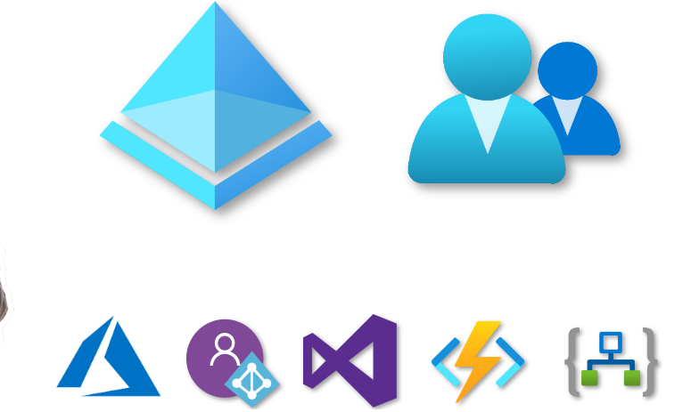
Azure external identities
Azure AD External Identities helps you to securely interact with users outside of your organization.
Azure external identities are a set of capabilities that enable organizations to secure and manage users outside their organization, such as customers, partners or guests.

Slide 13
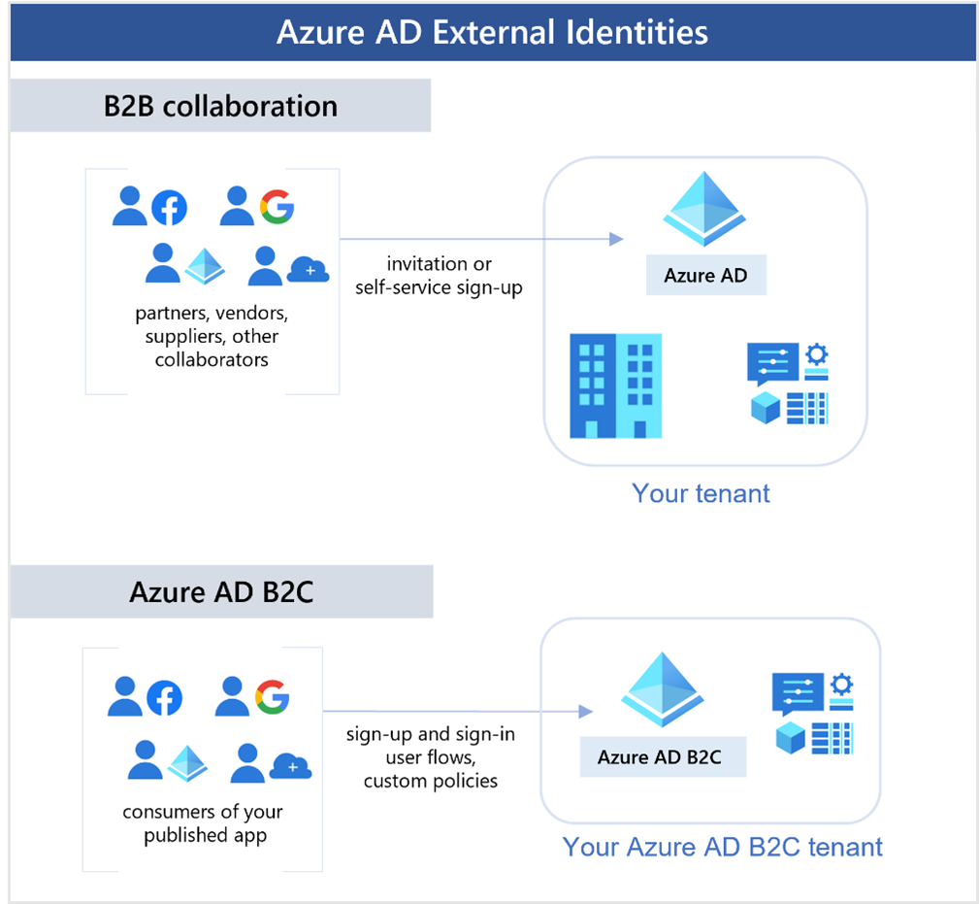
Capabilities make up External Identities
External user’s identity provider manages their identity, and you manage access to your apps with Azure AD or Azure AD B2C to keep your resources protected.
Notes:
Chapter4 – Azure Active Directory
The following capabilities make up External Identities:
B2B collaboration - Collaborate with external users by letting them use their preferred identity to sign into your Microsoft applications or other enterprise applications (SaaS apps, custom-developed apps, etc.). B2B collaboration users are represented in your directory, typically as guest users.
B2B direct connect - Establish a mutual, two-way trust with another Azure AD organization for seamless collaboration. B2B direct connect currently supports Teams shared channels, enabling external users to access your resources from within their home instances of Teams. B2B direct connect users aren't represented in your directory, but they're visible from within the Teams shared channel and can be monitored in Teams admin center reports.
Azure AD B2C - Publish modern SaaS apps or custom-developed apps (excluding Microsoft apps) to consumers and customers, while using Azure AD B2C for identity and access management.

Slide 14
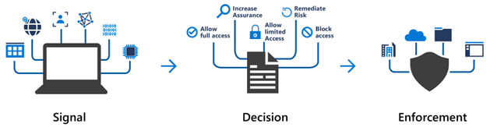
Azure conditional access
It is a tool used by Azure Active Directory to allow or deny access to resources based on identity signals.
Notes:
Chapter4 – Azure Active Directory
Conditional Access polices (identity signals includes) generally answers a questions like ”Who as access to what, from what location, using what device?”

Slide 15
Benefits of conditional access
Blocks unauthorized users
Prevents authorized users
Improves productivity
Helps administrators
Contextual access
Notes:
Chapter4 – Azure Active Directory
Blocks unauthorized users from accessing sensitive or private digital assets, thus reducing the possibility of security incidents.
Prevents authorized users from sharing or creating copies of proprietary information.
Helps administrators to make the right decisions as well as to enforce effective organizational policies.
Improves productivity by having users sign in using MFA only when specific signals require it.
Contextual access could block any login attempts from countries where no employees are.

Slide 16
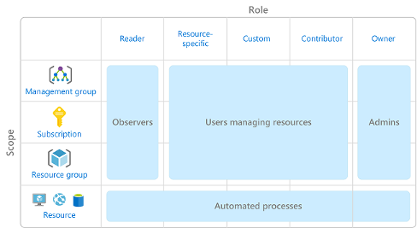
Azure role-based access control(RBAC)
Role-based access control (RBAC) is an authorization system built on Azure Resource Manager that provides fine-grained access management of resources in Azure.
You grant access by assigning the appropriate RBAC role to users, groups, and applications at a certain scope.
Notes:
Chapter4 – Azure Active Directory
How RBAC is applied to resources.
Role-based access control is applied to a scope, which is a resource or set of resources that this access applies to.
The above diagram shows the relationship between roles and scopes.
A management group, subscription, or resource group might be given the role of owner, so they have increased control and authority. An observer, who isn't expected to make any updates, might be given a role of Reader for the same scope, enabling them to review or observe the management group, subscription, or resource group.
Scopes include:
A management group (a collection of multiple subscriptions).
A single subscription.
A resource group.
A single resource.
Observers, users managing resources, admins, and automated processes illustrate the kinds of users or accounts that would typically be assigned each of the various roles.

Slide 17
RBAC use-cases
Allow one user to manage virtual machines in a subscription and another user to manage virtual networks
Allow a database administrator group to manage SQL databases in a subscription
Allow a user to manage all resources in a resource group, such as virtual machines, websites, and subnets
Allow an application to access all resources in a resource group

Slide 18
zero trust model
Zero Trust is a security strategy. It is not a product or a service, but an approach in designing and implementing the following set of security principles:
Verify explicitly
Use least privilege access
Assume breach
Notes:
Chapter4 – Azure Active Directory
Verify explicitly - Always authenticate and authorize based on all available data points.
Use least privilege access - Limit user access with Just-In-Time and Just-Enough-Access (JIT/JEA), risk-based adaptive policies, and data protection.
Assume breach - Minimize blast radius and segment access. Verify end-to-end encryption. Use analytics to get visibility, drive threat detection, and improve defenses.

Slide 19
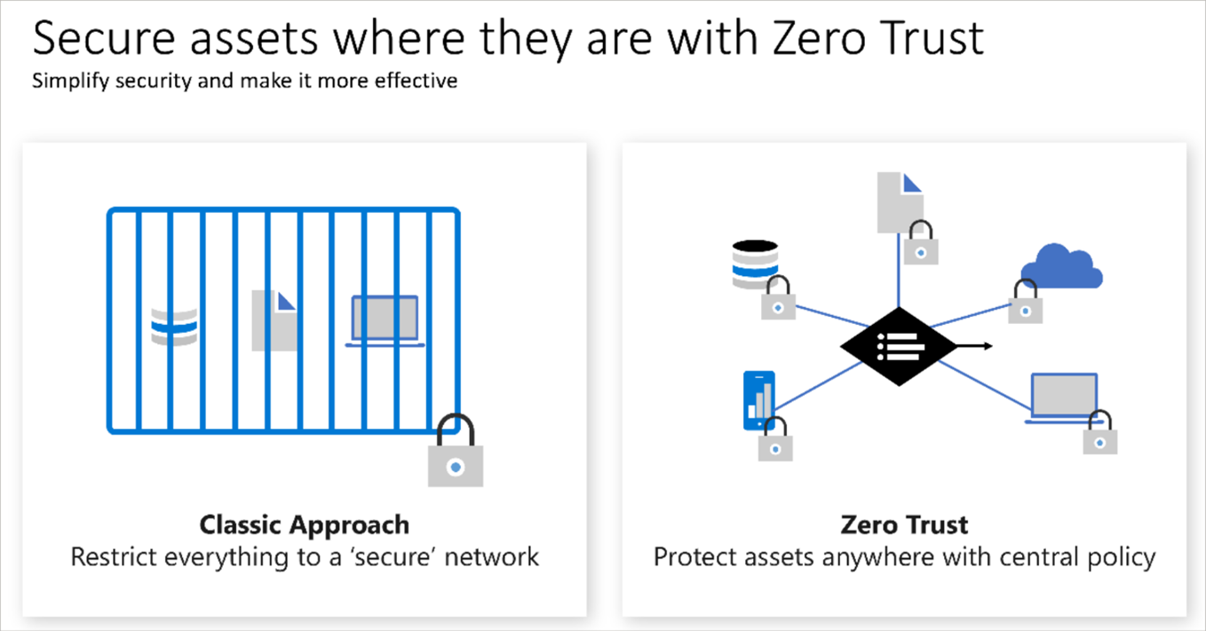
Notes:
Chapter4 – Azure Active Directory
Classic Approach will deny all in order to protect network.
Zero Trust will protect your infrastructure assets anywhere based in central policy.

Slide 20
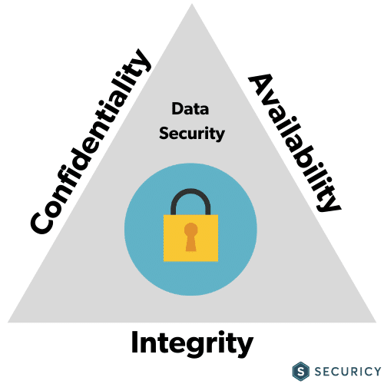
Défense-in-depth
Defense in Depth is a security strategy that prevents data
Notes:
Chapter4 – Azure Active Directory
Confidentiality-This pillar ensures that the ‘protect surface’ can be accessed only by those who have been granted direct/express permission.
Integrity– A unique fingerprint of the data is created by using a one-way hashing algorithm. The receiver is then sent the hash. The goal of integrity is to preserve the data throughout the transmission. Therefore, after the recipient receives the hash, he/she can recalculate the original value of the hash and compare the values to detect data consistency.
Availability-Data should be made available only to authentic users. Authentic users shouldn’t be denied access. This happens in a DDOS or a Distributed Denial of Service attack wherein even bona fide users are denied access.

Slide 21
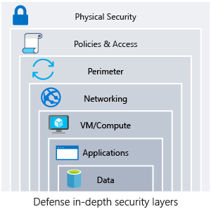
Layers in Defense in Depth
Security in the Defense in Depth strategy is multi-layered.
Notes:
Chapter4 – Azure Active Directory
Physical security layer is the first line of defense to protect computing hardware in the datacenter.
Identity and access layer controls access to infrastructure and change control.
Perimeter layer uses distributed denial of service (DDoS) protection to filter large-scale attacks before they can cause a denial of service for users.
Network layer limits communication between resources through segmentation and access controls.
Compute layer secures access to virtual machines.
Application layer helps ensure that applications are secure and free of security vulnerabilities.
Data layer controls access to business and customer data that you need to protect.

Slide 22
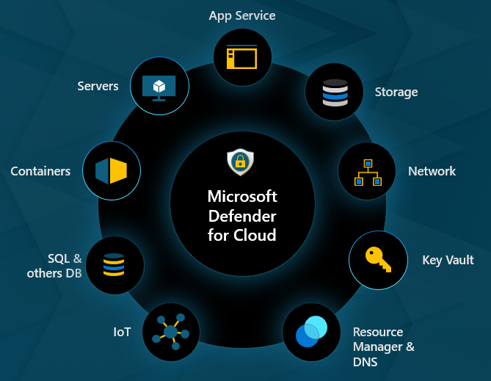
Microsoft Defender for Cloud
A monitoring tool that secure your cloud-based, on-premises, hybrid, and multicloud environments from various cyber threats and vulnerabilities.
Notes:
Chapter4 – Azure Active Directory
Azure Defender also analyzes signals from Azure network fabric and the service control plane, to detect threats across all Azure resources. It also protects non-Azure resources, utilizing Azure Arc, including those on-premises and in both AWS and GCP (once they've been onboarded).

Slide 23
THANK YOU

